Slide 1
ARRAYS
Atom #1

Slide 2
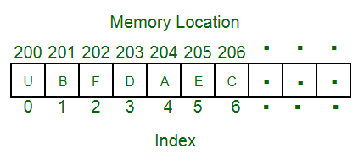
Arrays
An array is a group of like-typed variables that are referred to by a common name.
The idea is to store multiple items of the same type together.
Each element can be uniquely identified by their index in the array
Items stored at contiguous memory locations.

Slide 3
DeclaratioN

Slide 4
Static
Static or global arrays are allocated memory on data segment and local arrays are allocated memory on stack segment.
Static Array declaration consists of three types:
Array declaration by specifying size int arr1[10];
Array declaration by initializing elements int arr[] = { 10, 20, 30, 40 }
Array declaration by specifying size and initializing elements int arr[6] = { 10, 20, 30, 40 }

Slide 5
Dynamic
Dynamically allocated arrays are allocated memory on heap
scanf("%d",&n); //Get input for number of block
Int *Arr = new int[n];
for (i =0 ; i < n ; i++)
{
cin>>Arr[i];
}
delete [] Arr;

Slide 6
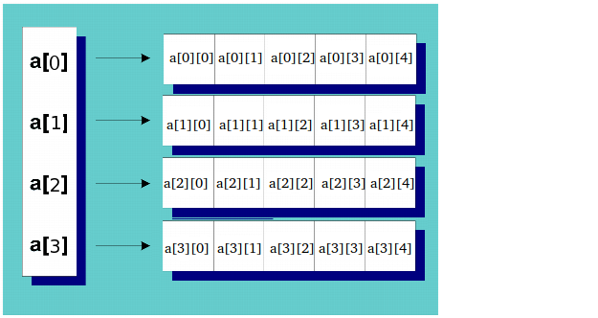
Two Dimensional array
int** a = new int*[rowCount];
for(int i = 0; i < rowCount; ++i)
a[i] = new int[colCount];

Slide 7
Vector in C++ STL
Vectors are same as dynamic arrays with the ability to resize itself automatically when an element is inserted or deleted, with their storage being handled by the container. Vector elements are placed in contiguous storage so that they can be accessed and traversed using iterators. In vectors, data is inserted at the end.

Slide 8
Certain functions associated with the vector are:
push_back() – It push the elements into a vector from the back
pop_back() – It is used to pop or remove elements from a vector from the back.
insert() – It inserts new elements before the element at the specified position
erase() – It is used to remove elements from a container from the specified position or range.
swap() – It is used to swap the contents of one vector with another vector of same type and size.
clear() – It is used to remove all the elements of the vector container
begin() – Returns an iterator pointing to the first element in the vector
end() – Returns an iterator pointing to the theoretical element that follows the last element in the vector

Slide 9
#include <iostream>
#include <vector>
using namespace std;
int main()
{
vector<int> v;
for (int i = 1; i <= 5; i++)
v.push_back(i);
for (auto i = v.begin(); i != v.end(); ++i)
cout << *i << " ";

Slide 10
// erases the vector
v.clear();
// fill the array with 10 five times
v.assign(5, 10);
for (int i = 0; i < v.size(); i++)
cout << v[i] << " ";
// inserts 15 to the last position
v.push_back(15);
int n = v.size();
cout << "\nThe last element is: " << v[n - 1];

Slide 11
// removes the first element
v.erase(v.begin());
cout << "\nThe first element is: " << v[0];
// two vector to perform swap
vector<int> v1, v2;
v1.push_back(1);
v1.push_back(2);
v2.push_back(3);
v2.push_back(4);
// Swaps v1 and v2
v1.swap(v2);
}

Slide 12
Time Complexity, Space Complexity and Big O notation
Time complexity is a function describing the amount of time an algorithm takes in terms of the amount of input to the algorithm.
Big O notation is used in Computer Science to describe the performance or complexity of an algorithm. Big O specifically describes the worst-case scenario, and can be used to describe the execution time required or the space used (e.g. in memory or on disk) by an algorithm.
Space complexity is a function describing the amount of memory (space) an algorithm takes in terms of the amount of input to the algorithm.

Slide 13
Basic Operations in an Array
Following are the basic operations supported by an array.
Traverse − print all the array elements one by one.
Insertion − Adds an element at the given index.
Deletion − Deletes an element at the given index.
Search − Searches an element using the given index or by the value.
Update − Updates an element at the given index.

Slide 14
Lets Code!

